Slide 1
Mom & Me
A Software System Solution for the Healing Hands Healthcare Practice
Edward Graft
Nadia Siddiqui
Neha Goel
Sarchina Kumari
INFS 492
FALL 2016
Group 4

Slide 2


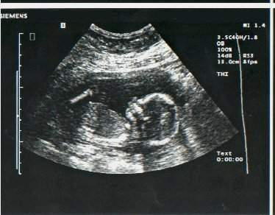
Agenda
Identify Business Needs
Mom & Me – as a Business Solution
Solution Development Process
Analysis Phase – Database Design – Application Demo
Quantitative Estimate

Slide 3
Business Need – Healing Hands
Improve efficiency of labor
Reduce redundant tasks for Doctors as well as practice staff
Take on more patients

Slide 4
Business Solution
Mom & Me
Software System Solution
By providing an online portal to patients the practice will receive these additional benefits:
Improve communication with patients
Improve efficiency
Reduce redundant tasks for Doctors as well as practice staff
Increase patient capacity
Improve revenue
Allow for additional re-investment opportunity into business technology
Eliminate unnecessary trips to the doctor’s office for expectant mothers

Slide 5
Solution Development
Planning & Analysis
Project Scope
System Description
Database Design
Data Diagrams
Application Demo
Dialogue Diagram
Requirements Definition
Distributed System Design
Example Forms

Slide 6
Planning & Analysis – Scope & System Description
Objective
To provide expectant mother with an online portal for information they need related to their pregnancy
Project Timeline
12-Months
(4Q17, October 2017)
Project Scope
System Mom and Me will be a web based application designed for the staff of “Healing hands” to counsel future mothers during different development stages of their baby keep and track off following information
Nutritional needs
Physical development
Photo albums
Possible symptoms
Item needs
System Description

Slide 7
Planning & Analysis – Requirements Definition
Details
Healing Hands
Staff enters the patient data in system
Staff will provide access to client for database
Doctors will provide their medication information and nutrition plan
Patient
The patient will login the system
Access all the necessary information
Can plan their baby shower and maintain food items list
Key Events
The web application will not have a busy time. It will be used year round. We will aim to do maintenance around 12am when most of our patients will be asleep and the doctors will not be in.

Slide 8
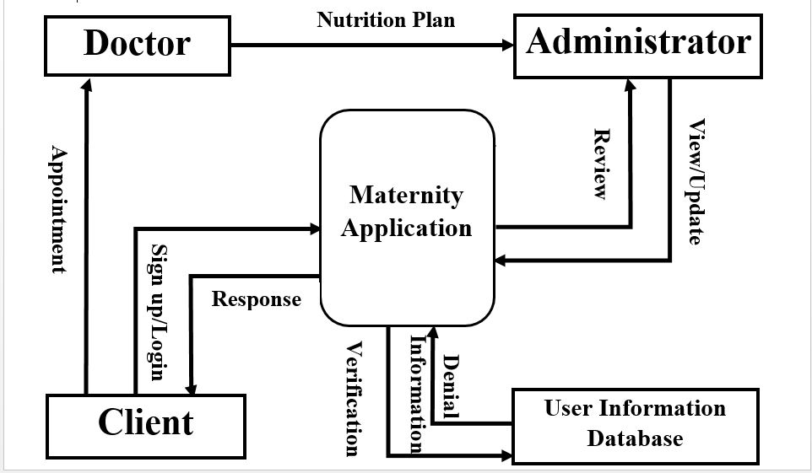
Database Design – Data Flow Context Diagram

Slide 9
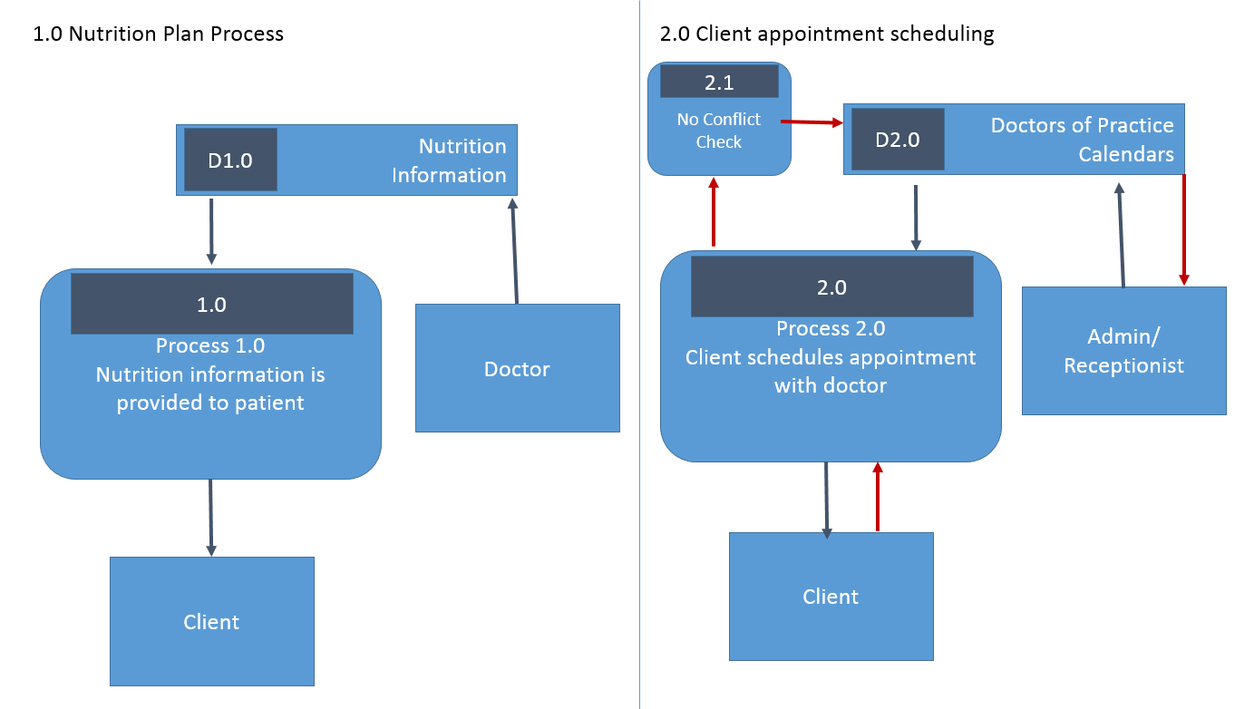
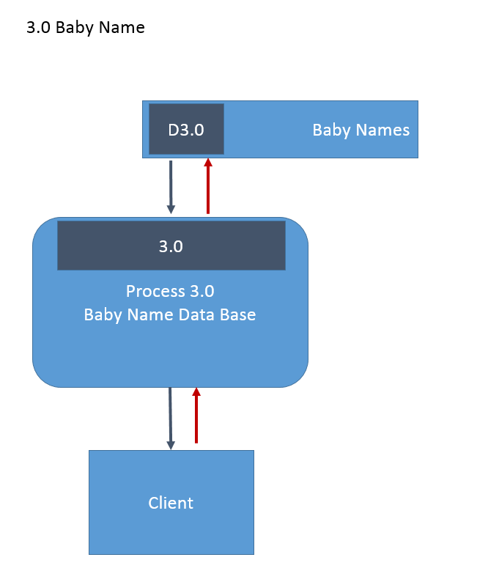
Database Design – Data Flow Level 0 Diagrams

Slide 10
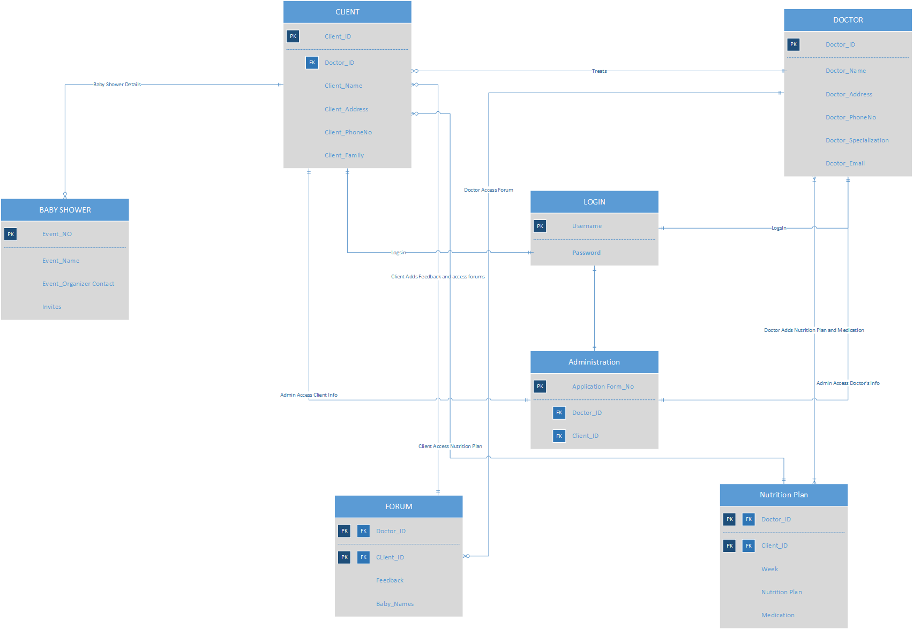
Database Deign - Entity Relationship Diagram
Data Format Notes
Data tables within the system database will be normalized
Data format controls will be implemented to maintain data continuity
Appendix A

Slide 11
Database Design – Distributed System Design
Geographical Information
The primary web server will be stored in a secure data resource center, with a backup service stored close by.
Physical Location
The primary web server will be housed on one of the server racks that that hospital is currently using. The backup server will also be housed on an existing hospital server.
Infrastructure Information
Both the primary and backup servers are housed in a secure data room, which requires a key card to gain access.
Personnel Characteristics
Both the primary and back up servers will be handled by trained personnel only who have experience in dealing with web servers and related functions.

Slide 12
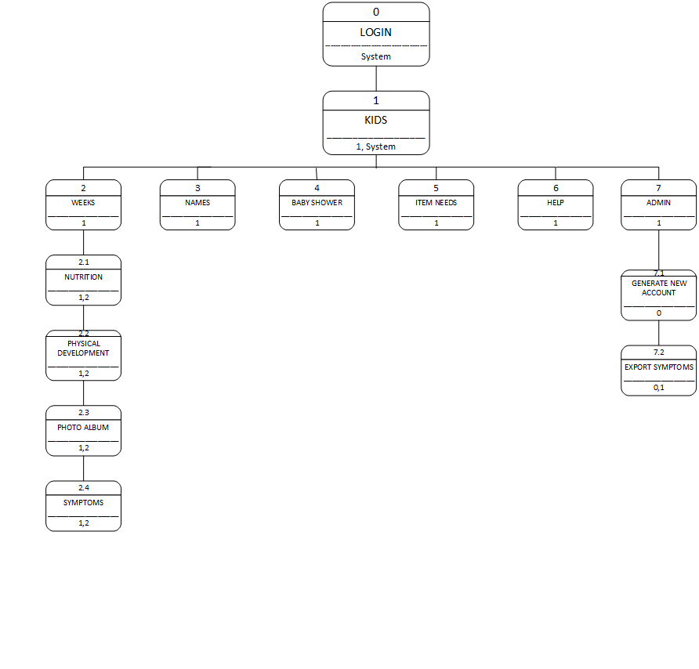
Application Demo – Dialogue Diagram

Slide 13
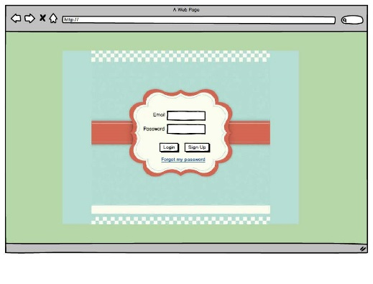
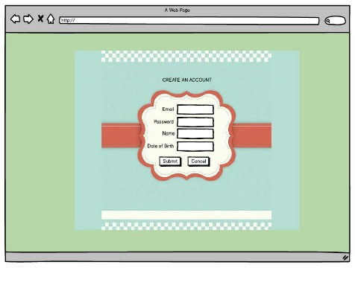
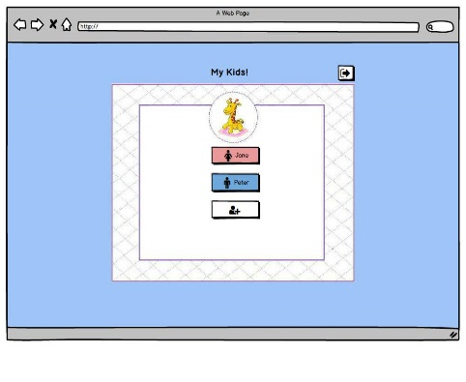
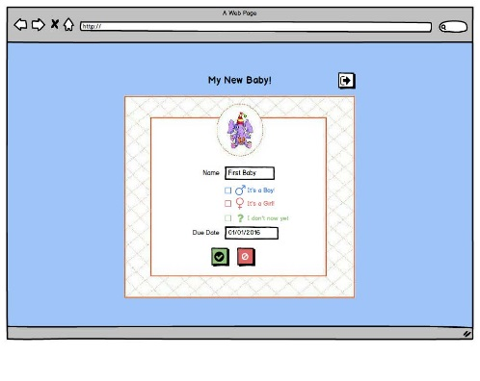
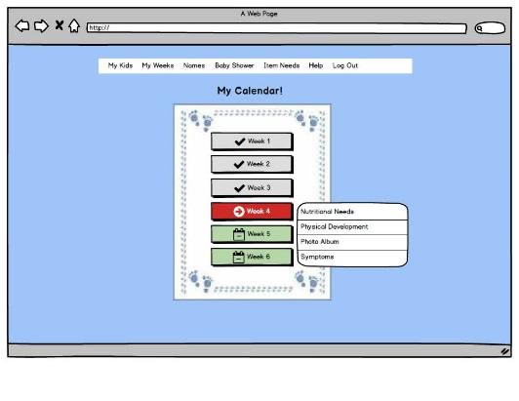
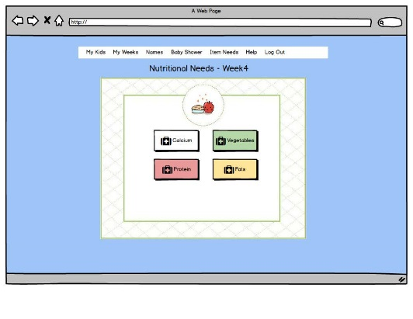
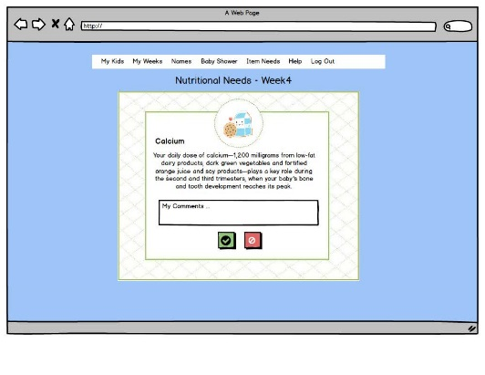
Application Demo – Forms (see pdf)

Slide 14
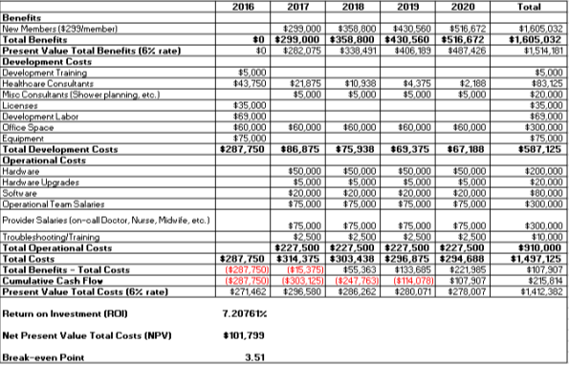
Quantitative Estimate

Slide 15
Thank you!

Slide 16
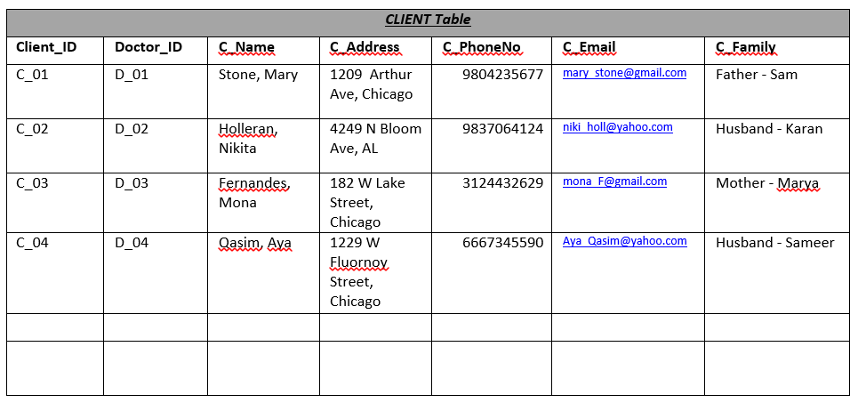
Appendix A
Example of Normalized Data Table
Data controls
All data fields have designated data types with character limits
Referential integrity
Data is secured from outside member access
Data is backed up nightly and physically stored on secured servers with limited physical access
Store each system data request for backup, as well as security reference if needed
File encryption

